Slide 1
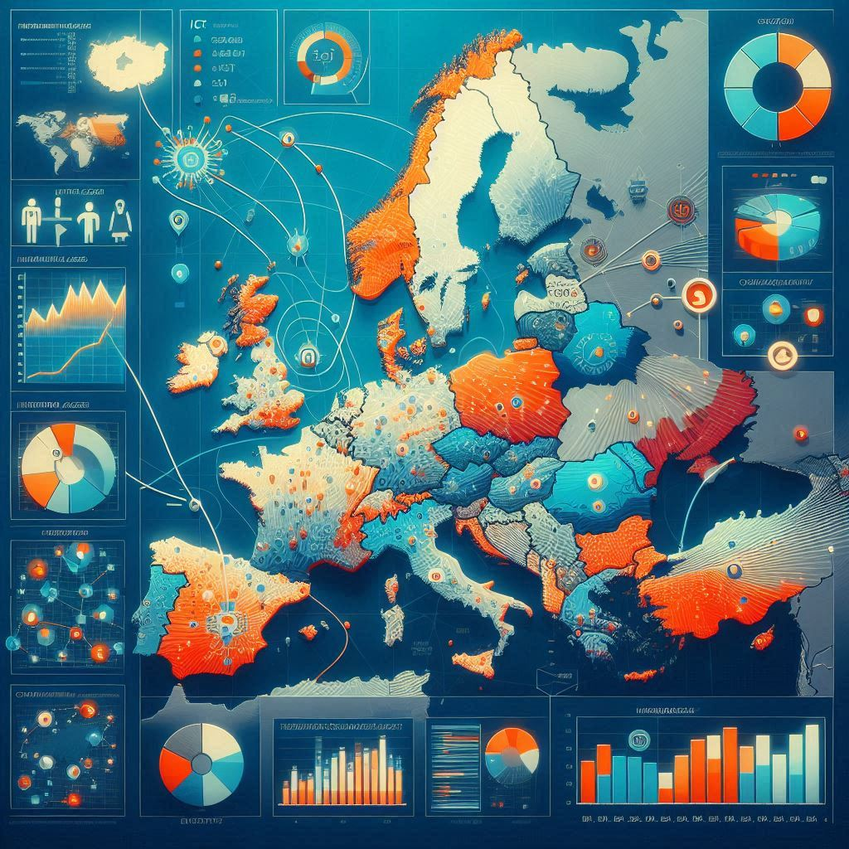
Eurostat Digital Landscape Analysis
Exploring the Relationship Between Internet Access and ICT Sector Development in European Countries
Dataset 1: Households with internet access (Last Update: 16/06/24 23:00:00)
Shows the proportion of households in each European country that have access to the internet at home. This is a key indicator of a country's digital infrastructure and the population's ability to participate in the digital economy.
https://ec.europa.eu/eurostat/databrowser/view/tin00134/default/table?lang=en&category=t_isoc.t_isoc_i.t_isoc_ici
Dataset 2: Employment in information and communication technology (ICT) sectors (Last Update: 23/04/24 23:00:00)
Shows the percentage of the workforce employed in ICT-related jobs in each European country.
https://ec.europa.eu/eurostat/databrowser/view/tin00085/default/table?lang=en&category=t_isoc.t_isoc_se

Slide 2
Introduction
Data Sources and Methodology
Data Origin
All data presented in this analysis is sourced from the Eurostat Database, the official statistical office of the European Union.
Data Currency
The datasets were last updated in April and June 2024, ensuring the analysis is based on the most recent available information.
Time Range
The datasets cover a 9-year period from 2012 to 2021, allowing for a comprehensive examination of trends and changes over nearly a decade.
Visualization:
All graphs and visual representations in this presentation were created using Jupyter Notebook, a powerful tool for data analysis.
(The file can be found in my documents: comparison_internet_access_employment_in_tech.ipynb)
Data Limitations and Considerations
Data Completeness
Due to the decentralized nature of data collection, with each European country responsible for providing its own data, there are some gaps in the datasets.
Country Exclusions
As a result of these data gaps, certain countries could not be included in this analysis. This limitation should be kept in mind when interpreting the results and drawing conclusions about Europe as a whole.
Potential Bias
The exclusion of countries with incomplete data may introduce some bias into the analysis, potentially overrepresenting countries with more robust data collection and reporting systems.

Slide 3
Introduction
Significance of the Analysis
Temporal Insights
The 9-year span of the data allows for the identification of long-term trends and patterns in internet access and ICT employment across Europe.
Policy Implications
This analysis can provide valuable insights for policymakers and researchers interested in digital development and labor market trends in the ICT sector.
Comparative Perspective
By examining multiple countries over time, we can gain a comparative understanding of digital progress across different European nations.
Interpretation Guidelines
When reviewing the findings, it's important to consider the contextual factors specific to each country, such as economic conditions, government policies, and technological infrastructure. The trends observed should be interpreted as indicative rather than definitive, given the data limitations mentioned.

Slide 4
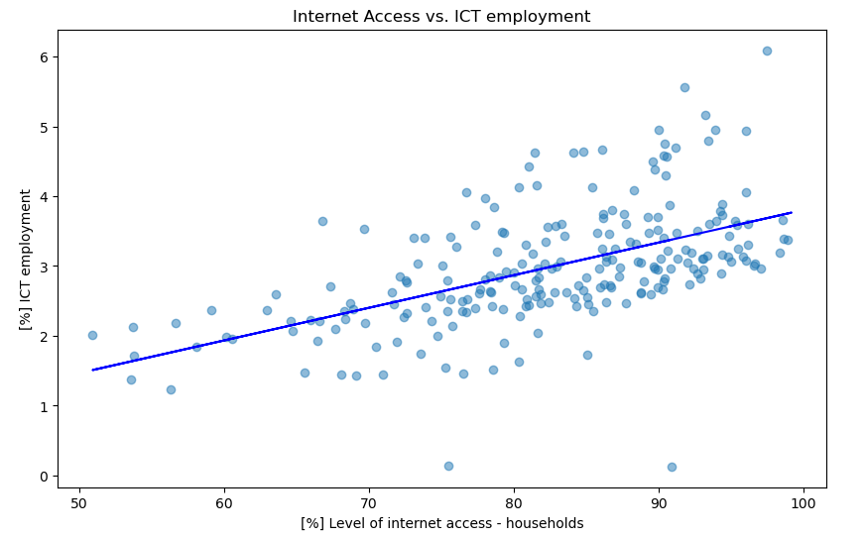
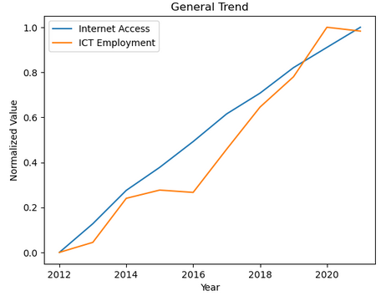
Internet access vs. ICT employment
Time series of all countries with data
Correlation coefficient: 0.55
= Moderate positive relationship

Slide 5
Internet access vs. ICT employment
Interpretation
Scatterplot (left): -> reveals a moderate positive correlation (r = 0.55) between internet access and ICT employment
Countries with higher rates of household internet access tend to have higher ICT employment rates
However, correlation does not imply causation
Line graph (right): -> illustrates the trends in internet access and ICT employment from 2012 to 2021
Internet access per household has shown consistent growth over the entire period.
ICT employment has generally increased, however with some fluctuations: (stagnation in 2014-2016 and 2020-2021 possibly influenced by the global COVID- 19 pandemic)
Combining insights from both graphs, it can be inferred that the data points clustered on the left side of the scatterplot likely correspond to earlier years in the time series, while those on the right represent more recent years.
The relationship between internet access and ICT employment appears to be dynamic over time. As internet access expanded, ICT employment generally grew, but not always at the same rate or with perfect consistency.

Slide 6
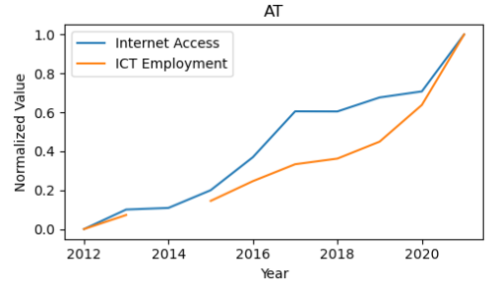
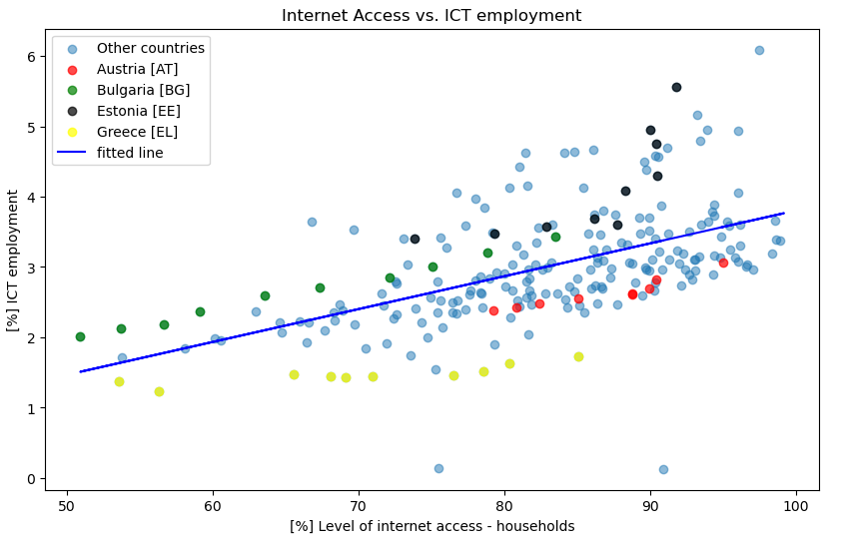
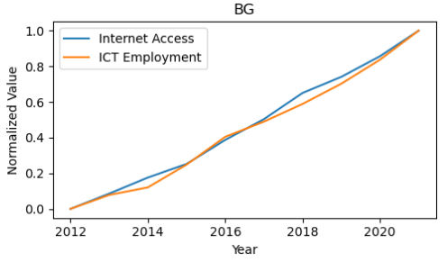
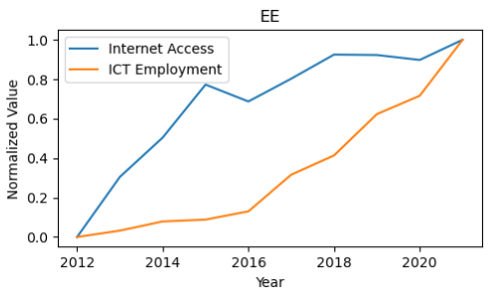
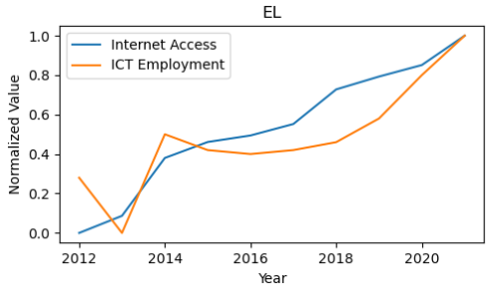
Internet access vs. ICT employment
Time series of selected countries
Selected Countries

Slide 7
Internet access vs. ICT employment
Selected Countries – Interpretation – Country analysis
The scatterplot highlights four countries - Austria, Bulgaria, Estonia, and Greece - each exhibiting unique patterns in the relationship between internet access and ICT employment.
Austria (red dots):
Steady increases in both internet access and ICT employment
Consistently remains below the regression line
Maintains high internet access but underperforms in ICT employment relative to the overall trend.
Bulgaria (green dots):
Distinctive pattern with relatively low internet access but high ICT employment
All data points remain above the regression line.
Known as the "Silicon Valley" of the Eastern Bloc, suggesting a strong focus on the ICT sector.
Estonia (black dots):
Starts with low internet access, maintains above-average ICT employment throughout
Experiences rapid ICT employment growth, especially post-2016
2021, reaches the second-highest ICT employment rate after Ireland. Suggests successful digital transformation strategies.
Greece (yellow dots):
Begins with one of the lowest internet access rates
Shows steady improvement in internet access over time
ICT employment remains stagnant, resulting in one of the lowest rates in Europe

Slide 8
Internet access vs. ICT employment
Selected Countries – Interpretation – Conclusion
Diverse Development Paths These four countries illustrate that the relationship between internet access and ICT employment is not uniform across nations. Factors such as economic conditions, government policies, and historical context play significant roles.
Internet Access vs. ICT Sector Growth Bulgaria and Estonia demonstrate that high ICT employment is possible even with lower internet access rates, suggesting other factors (e.g., education, government initiatives) may be more crucial for ICT sector development.
Resilience and Adaptability Estonia's trajectory showcases how a country can rapidly transform its ICT sector, potentially offering orientational insights for other nations aiming to boost their digital economies.
Economic Challenges and ICT Growth Greece's case highlights how broader economic issues can hinder ICT sector development, even as internet access improves.
Policy Implications The divergent paths of these countries suggest that policymakers should consider a holistic approach to ICT sector development, not focusing solely on increasing internet access.

Slide 9
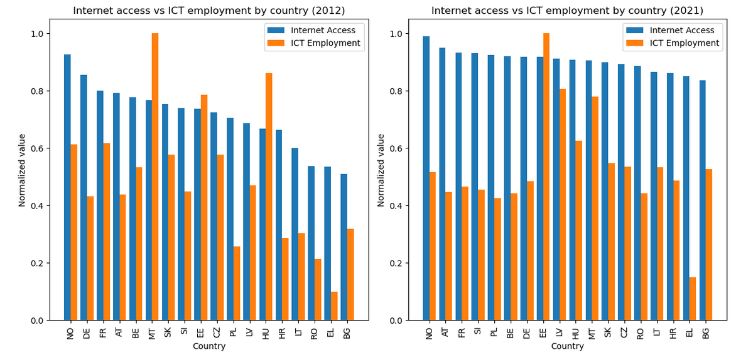
Country Comparison
2012
Mean internet access: 71.0 %
Mean ICT employment: 2.5 %
2021
Mean internet access: 90.6 %
Mean ICT employment: 3.5 %

Slide 10
Country Comparison
Interpretation 1
The bar charts offer a detailed comparison of internet access and ICT employment rates across 18 European countries in 2012 and 2021. These countries were selected based on the availability of complete data for both years, ensuring a consistent comparison over time.
Key Findings and Explanations:
Overall Growth:
Internet access increased by 19.6 percentage points (27.6% growth) from 2012 to 2021.
ICT employment grew by 1 percentage point (40% growth) in the same period.
Why: This reflects a rapid growth in internet access and a marginal growth in ICT employment across Europe, which might be driven by technological advancements, EU digital agenda policies, and increasing demand for digital services.
Faster Growth in Internet Access:
The rate of increase for internet access (19.6%) outpaced that of ICT employment (1%).
Why: Expanding internet infrastructure is often easier and quicker than developing a skilled ICT workforce. The latter requires time for education, training, and job market adjustments.
Narrowing Digital Divide:
The higher growth rate in internet access suggests a narrowing digital divide among these European countries.
Why: EU initiatives, national policies, and increasing recognition of internet access as a necessity have likely contributed to this trend.
Resilience of ICT Sector:
Despite economic challenges (e.g., Eurozone crisis, COVID-19 pandemic), ICT employment showed steady growth.
Why: The ICT sector's resilience may be attributed to the increasing digitalization of various industries and the growing importance of technology in both business and everyday life.

Slide 11
Country Comparison
Interpretation 2
Potential for Further Growth:
ICT employment averaged in 2021 with 3.5%, suggesting room for further expansion.
Why: As economies continue to digitalize and new technologies emerge (e.g., AI, IoT), demand for ICT professionals is likely to increase further.
Varied Country Performances:
While not visible in the averages, individual country performances varied significantly.
Why: Differences in economic structures, education systems, and national digital strategies can lead to divergent outcomes in ICT sector development.
Internet Access Approaching Saturation:
With 90.6% mean internet access in 2021, some countries may be approaching saturation.
Why: Achieving 100% internet access is challenging due to factors like remote areas, elderly populations, and economic barriers.
ICT Employment Growth Potential:
Compared to the rapidly growing internet access, the slower ICT employment development may offer the opportunity for future job creation in this sector.
Why: As more of the economy becomes digitalized, there may be a lag in workforce adaptation, indicating future growth opportunities.

